Slide 1

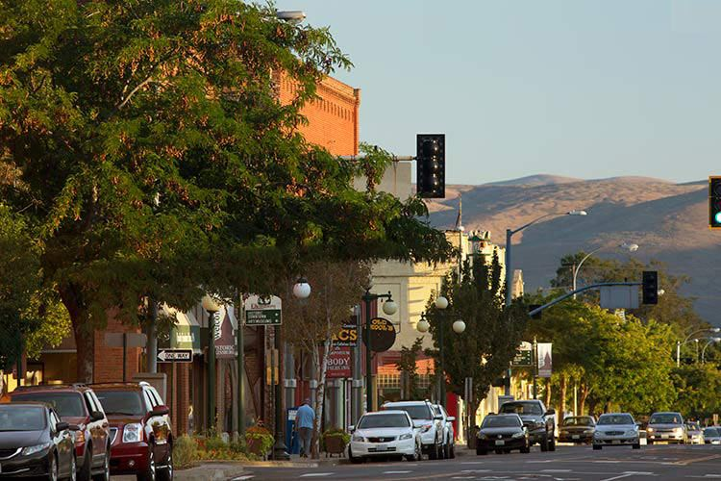



Ellensburg Sleep Center
Feasibility Analysis Report
March 2024

Slide 2

Background & Context
Existing Cold Weather Shelter
    Operated by the KVMA
Boise v. Martin
    Shelter beds required to enforce camping ordinances in both city and county
Regulatory Context for Emergency Shelters in Ellensburg
    City Land Development Code updated February 5, 2024 to comply with HB 1220

Slide 3




Analysis Components
SITE ANALYSIS
OPERATION
COST ANALYSIS
Identifying and evaluating sites
    Site Criteria
    Site Search
    Site Selection
Desired framework for Sleep Center operation
    Shelter operations in WA
    Year-round overnight shelter components
Detailed assumptions and considerations for cost analysis
    Site prep costs
    Building costs
    Ongoing operating costs
    Expansion costs

Slide 4
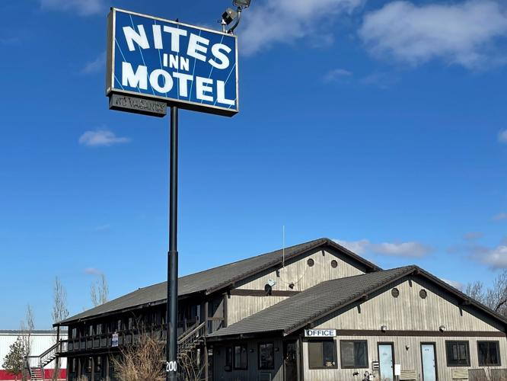


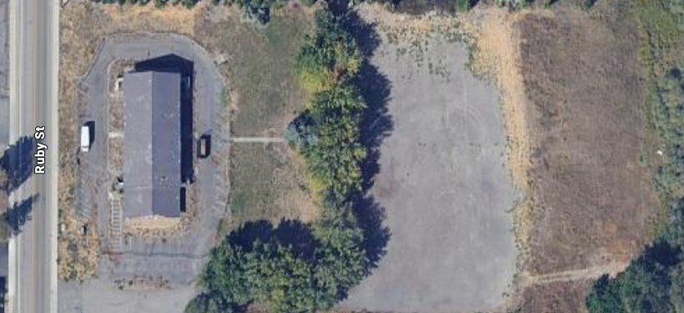

Site Analysis
Site Search Criteria
Zoning, Site Size, Adjacent Uses, Accessibility, Lease vs Own
Add pic of new site
Image here
Methods for Site Search
CoStar & Vacant Lands Analysis
Source: Ellensburg Daily Record
Selected Site
Pathways property – area behind the former Nites Inn Motel

Slide 5
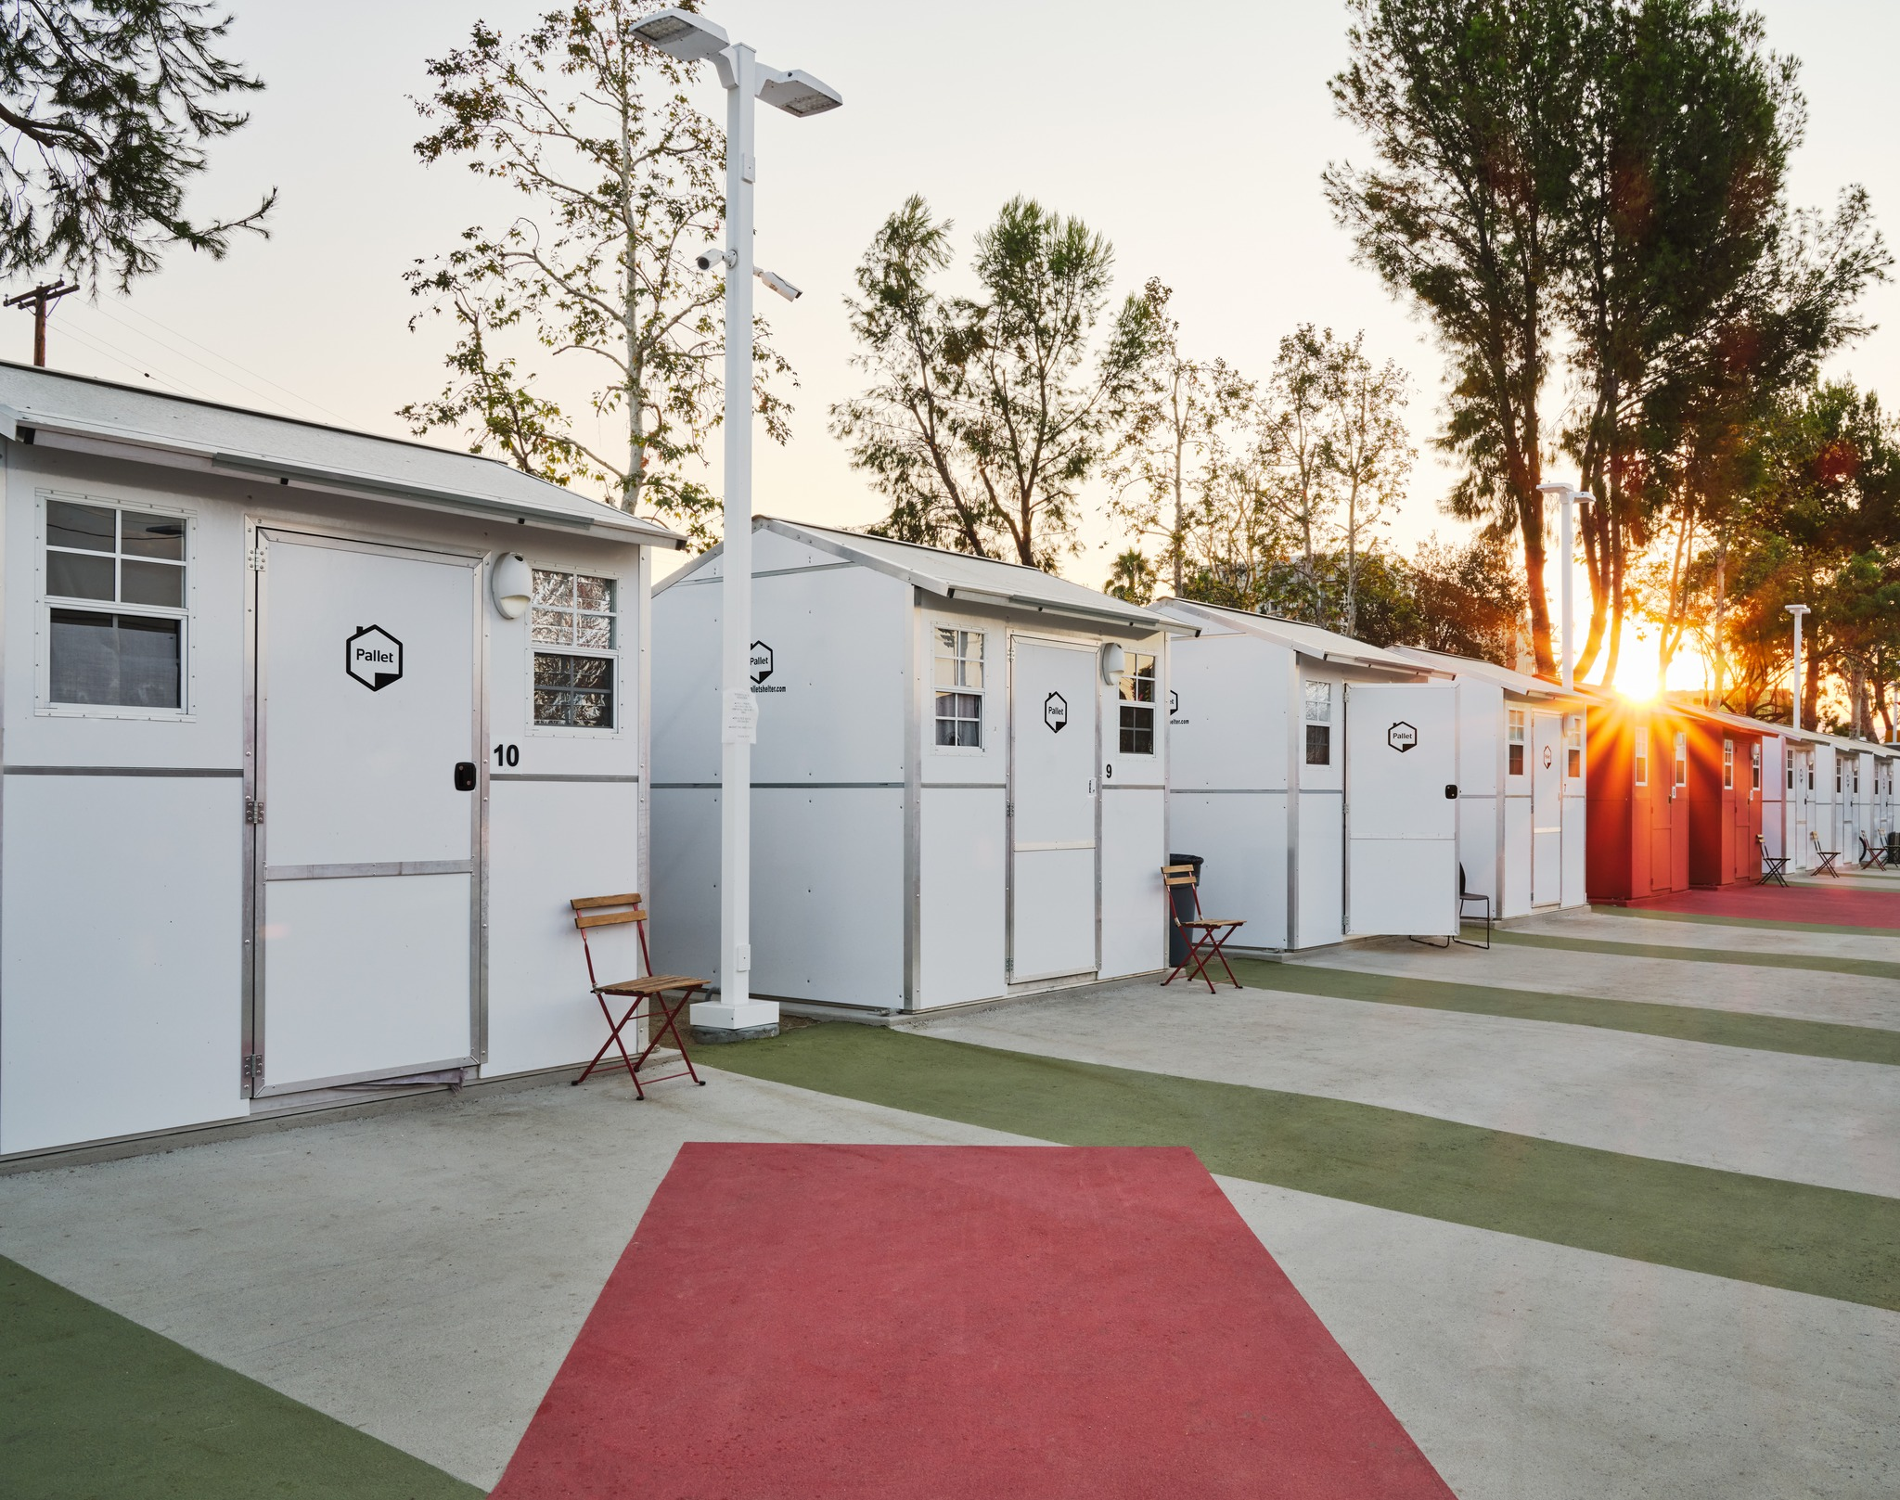
Operating Framework
Year-round operation open 6PM to 8AM
Up to 25 individual use shelters with heating and cooling
Staff office, bathroom and shower units, community areas
Ideally would provide meals, storage, onsite social services, and other amenities
    Laundry, pet area, WiFi, landscaping
Security measures
    Fencing, cameras and onsite overnight security
Photo Credit: Pallet Shelter

Slide 6
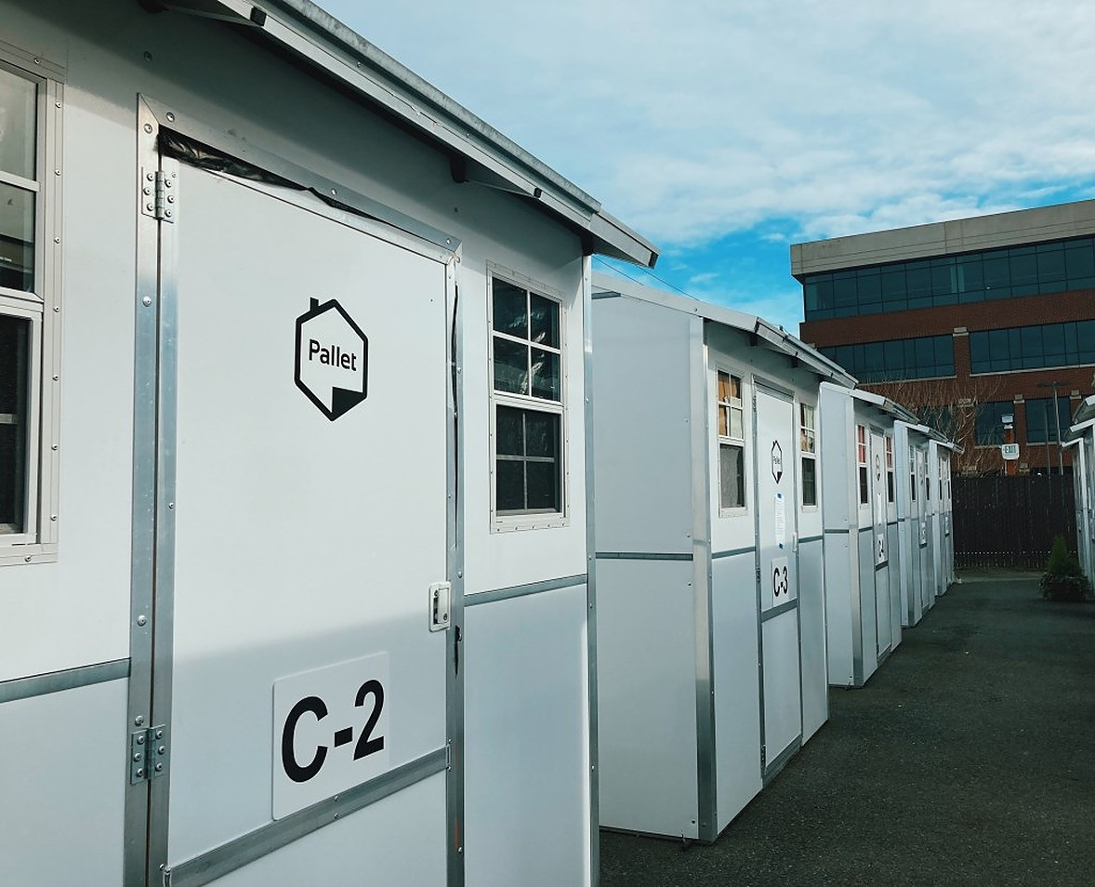
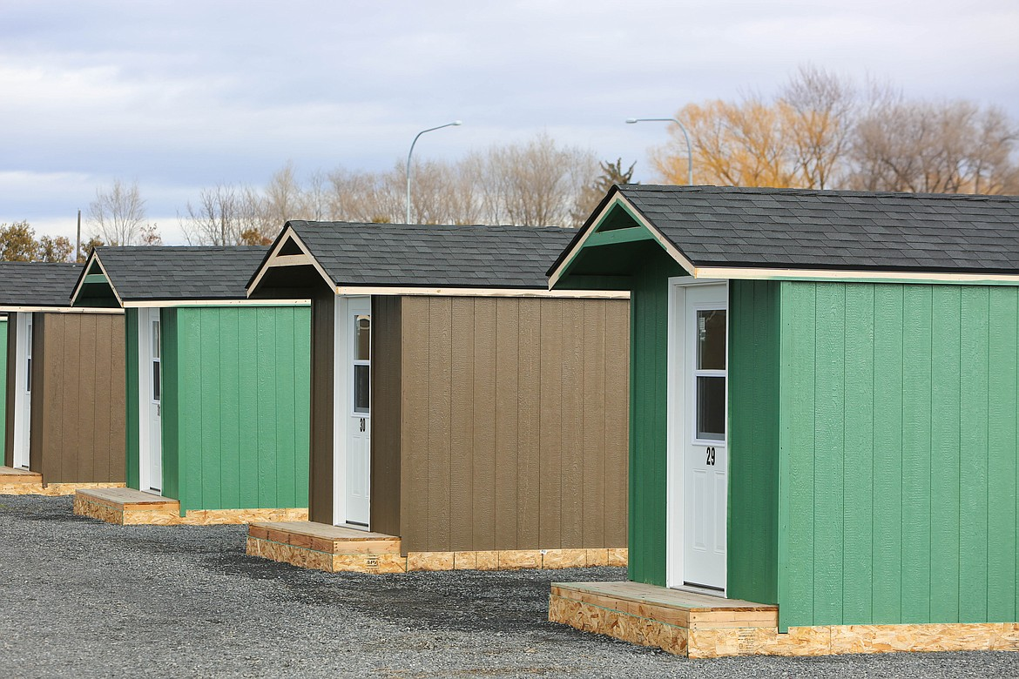
Shelter Type Choices
Sheds, Moses Lake Sleep Center
Pallet Shelters, Seattle

Slide 7
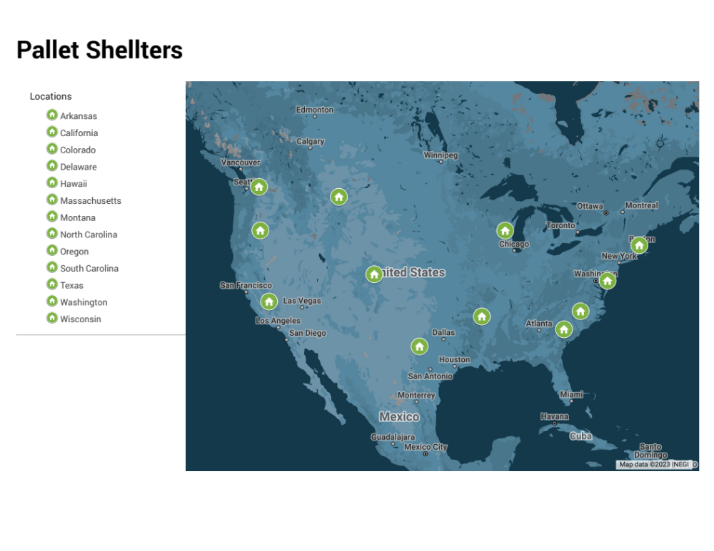
Pallet Shelter Locations

Slide 8
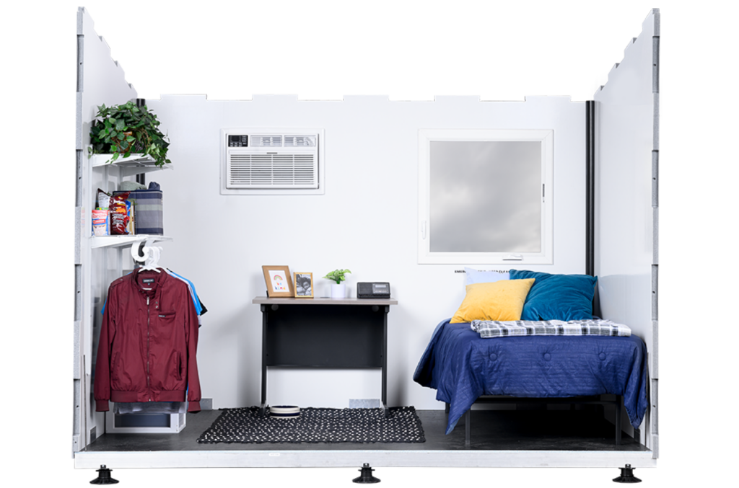
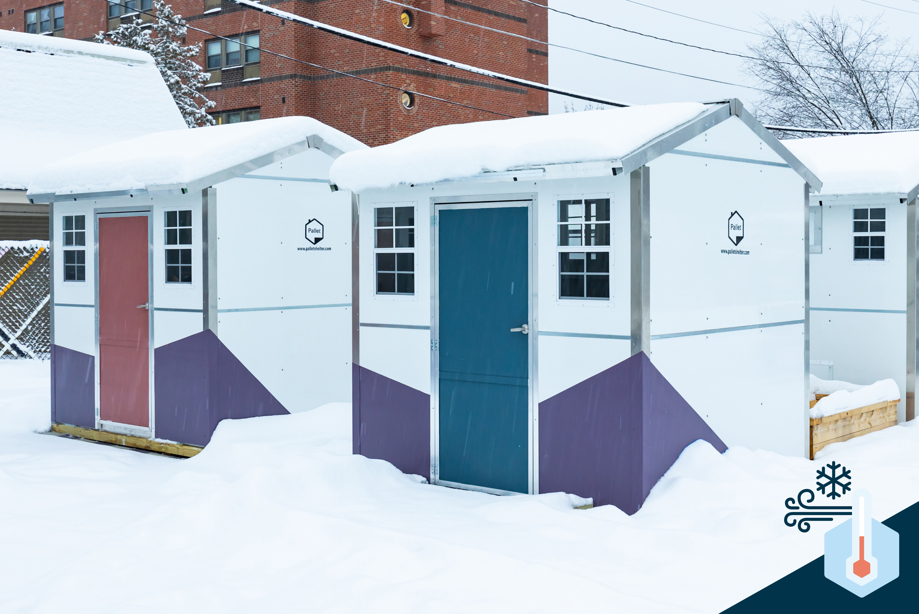
Pallet Shelters
Interior of Pallet Shelter Unit
Source: Pallet Shelter
Pallet Shelter, Burlington, VT
Source: Pallet Shelter

Slide 9
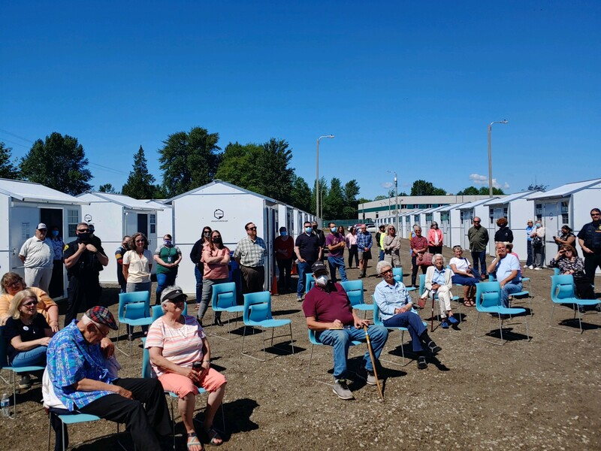
Pallet Shelters in Washington
Everett
Tacoma
Burlington
Walla Walla
Tulalip
+ more!
Skagit First Step, Burlington, WA

Slide 10



Cost Analysis Overview
Site Preparation
Building Infrastructure
Operating Costs
Expansion Costs
Excavations
Sewer, electric, and water connections
Landscaping, lighting, and fencing
Shelters
Bathroom and shower units
Staff offices, community room and other amenities
Staffing and security
Program expenses, including utilities and leases
Maintenance costs
Adding two new shelters per year for a total of 43 shelters after 10 years

Slide 11
Site Preparation Costs
Total:
~ $394,000
Considerations:
Infrastructure and utility improvement costs estimated by City Public Works staff
Improvements include adding water, sewer, electrical, and hardscaping to the sight
Soft costs (sales tax, cost contingency, and escalations) come to ~$72,000

Slide 12
Building Costs
Totals:
Pallet: $675,900
Non-Pallet (own): $492,400
Non-Pallet (lease): $306,900
Considerations:
Shelter costs make up the majority of the cost difference between scenarios
City could potentially “mix and match” building components
Pallet shelters advantages: set-up, warranty, safety, replacement options and mobility.

Slide 13
Operating Costs per Year
Totals:
Site A: $326,000
Site B: $409,000
Totals:
Pallet: $377,800
Non-Pallet (own): $401,000
Non-Pallet (lease): $452,300
Considerations:
Tuff sheds likely to have much greater maintenance and upkeep costs
While leasing infrastructure requires no upfront cost, doing so results in high annual costs
Because the City is providing site infrastructure improvements, there are no leasing costs

Slide 14
Ten Year Expansion Costs
Total costs for expanding from 25 to 43 shelters over ten years (two new shelters per year).
Does not consider maintenance or upkeep costs
Tuff sheds present major maintenance and longevity concerns

Slide 15
Q&A
Thank you!

